Slide 1
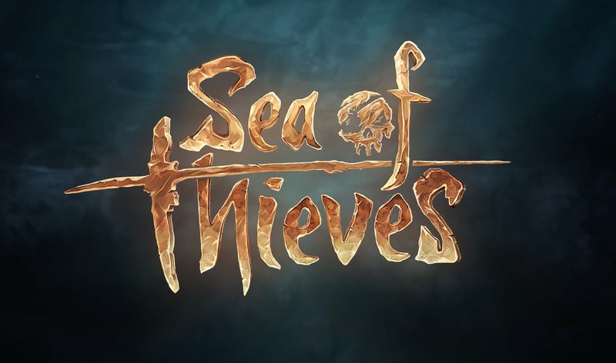

Rare Studios – Insider Dynamics Program
Business Need
Affirma supports and maintains Rare’s Dynamics instance for their highly popular game, Sea of Thieves. A primary use case Dynamics for Rare is to run their insider community for their most passionate gamers.
Rare had the following needs to expand their Dynamics solution.
Improved data warehouse solution that could consume data from multiple sources and pipelines
Process partner data in a time effective way
What We Did
Designed, executed, and delivered two complex Azure Data Factory solutions for Rare's data warehouse requirement.
Update Dynamics objects, workflows, and permissions to allow data integration with the new data warehouse.

